Slide 1
Theory of Automata and Formal Language
Lecture-32
Dharmendra Kumar
(Associate Professor)
Department of Computer Science and Engineering United College of Engineering and Research, Prayagraj March 30, 2021

Slide 2
PDA examples continue
Construct PDA to accept the following languages:-
L = { w ! w ∈ {a,b}* and n_{a}(w) = n_{b}(w) }
L = { w ! w ∈ {a,b}* and n_{a}(w) ≥ n_{b}(w) }
L = { w ! w ∈ {a,b}* and n_{a}(w) ≠ n_{b}(w) }

Slide 3
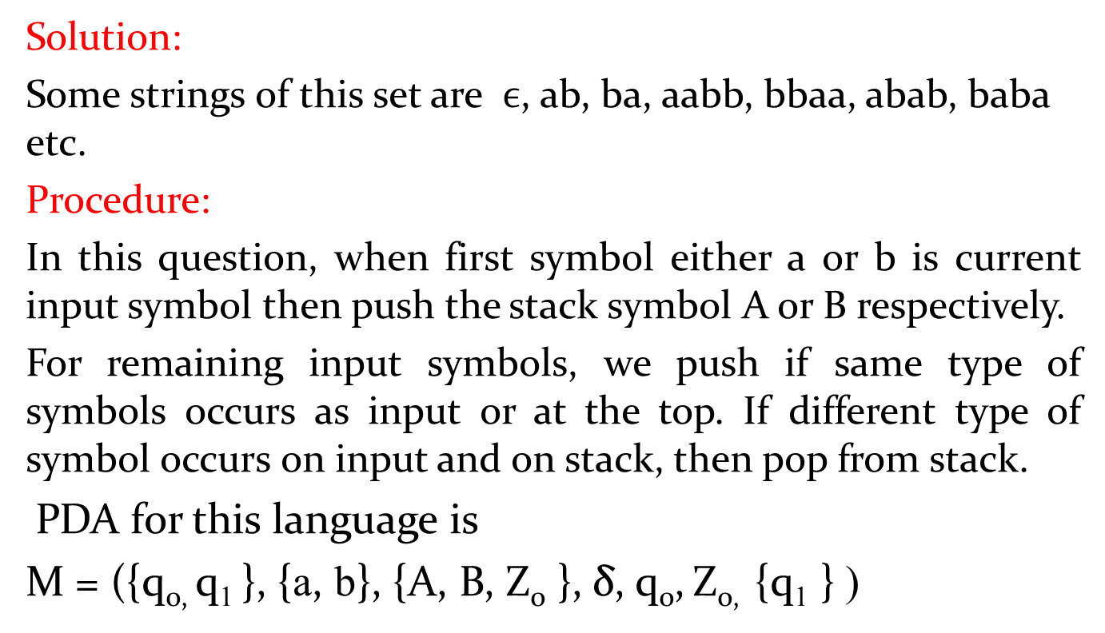
Ex. L = { w ! w ∈ {a,b}* and n_{a}(w) = n_{b}(w) }
Solution:
Some strings of this set are $ϵ$, ab, ba, aabb, bbaa, abab, baba etc.
Procedure:
In this question, when first symbol either a or b is current input symbol then push the stack symbol A or B respectively.
For remaining input symbols, we push if same type of symbols occurs as input or at the top. If different type of symbol occurs on input and on stack, then pop from stack.
PDA for this language is
M = ({q_{0,} q₁}, {a, b}, {A, B, Z₀ }, δ, q₀,Z_{0,} {q₁ } )

Slide 4



PDA examples continue
δis defined as following:-
δ(q₀, a, Z₀) = {(q₀, AZ₀ )} δ(q₀, b, Z₀) = {(q₀, BZ₀)}
δ(q₀, a, A) = {(q₀, AA )} δ(q₀, b, B) = {(q₁, BB )}
δ(q₀, a, B) = {(q₀, $ϵ$ )}δ(q₀, b, A) = {(q₂, $ϵ$ )}
δ(q₀, $ϵ$, Z₀) = {(q₁, Z₀)}
Transition diagram of PDA for above language is
a, A/AA
b, B/BB
a,B/$ϵ$
b, A/$ϵ$
a, Z₀/AZ₀
b, Z₀/BZ₀
q₀
q₁
$ϵ ,$Z₀/Z₀

Slide 5
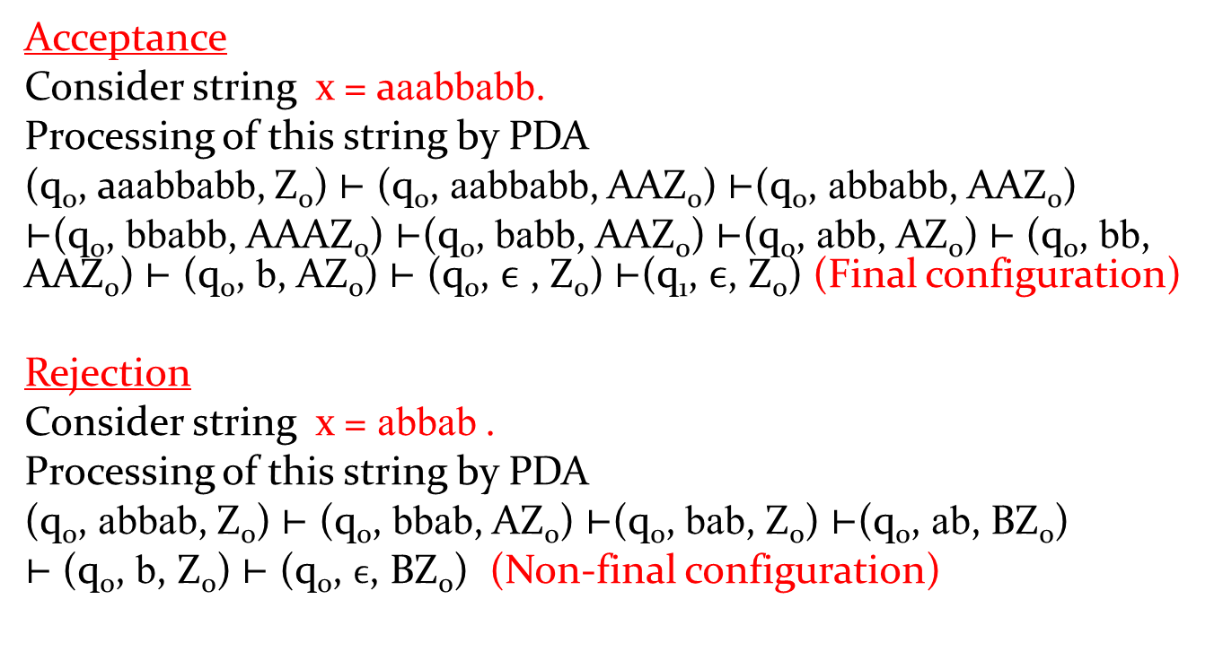
Processing and Verification of above PDA
Acceptance
Consider string x = aaabbabb.
Processing of this string by PDA
(q₀, aaabbabb, Z₀) ⊢ (q₀, aabbabb, AAZ₀) ⊢(q₀, abbabb, AAZ₀)
⊢(q₀, bbabb, AAAZ₀) ⊢(q₀, babb, AAZ₀) ⊢(q₀, abb, AZ₀) ⊢ (q₀, bb, AAZ₀) ⊢ (q₀, b, AZ₀) ⊢ (q₀,$ϵ$ , Z₀) ⊢(q₁, $ϵ$, Z₀) (Final configuration)
Rejection
Consider string x = abbab.
Processing of this string by PDA
(q₀, abbab, Z₀) ⊢ (q₀, bbab, AZ₀) ⊢(q₀, bab, Z₀) ⊢(q₀, ab, BZ₀)
⊢ (q₀, b, Z₀) ⊢ (q₀, $ϵ$, BZ₀)(Non-final configuration)

Slide 6
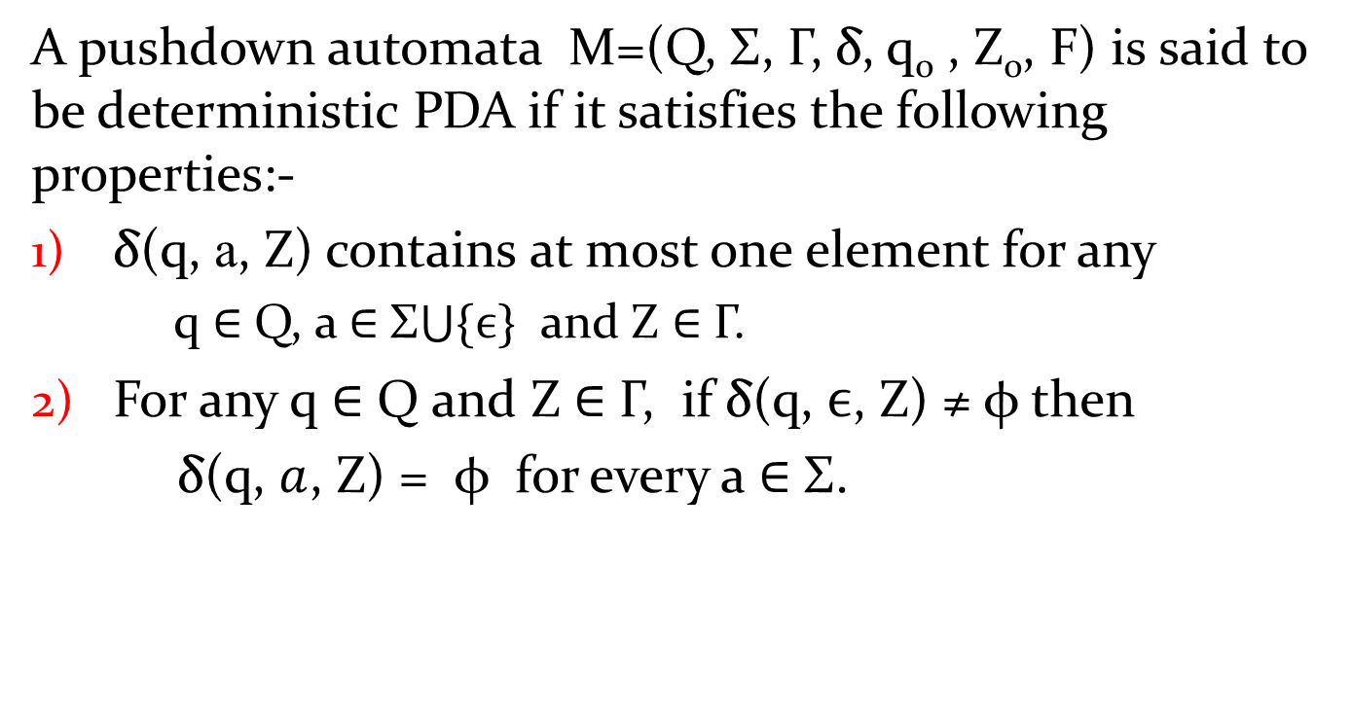
Deterministic Pushdown Automta(DPDA)
A pushdown automata M=(Q, Σ, Γ,δ, q₀ , Z₀, F) is said to be deterministic PDA if it satisfies the following properties:-
δ(q, a, Z) contains at most one element for any
q∈ Q, a ∈ Σ$\bigcup{\{ϵ\}}$ and Z ∈ Γ.
For any q ∈ Q and Z ∈ Γ, if δ(q, $ϵ$, Z) ≠ φ then
δ(q, $a$, Z) = φ for every a ∈ Σ.

Slide 7
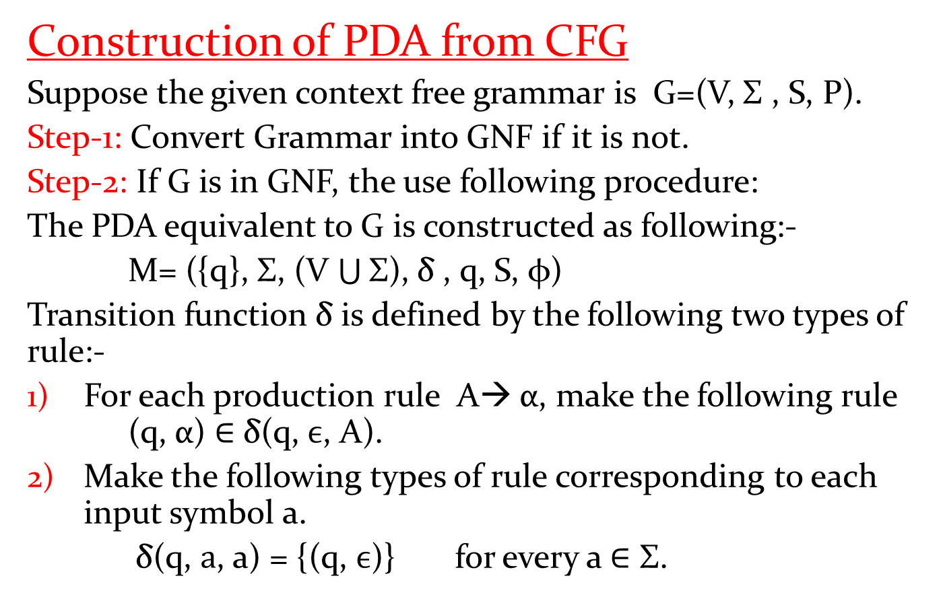
Equivalence of PDA and CFG
Construction of PDA from CFG
Suppose the given context free grammar is G=(V, Σ , S, P).
Step-1: Convert Grammar into GNF if it is not.
Step-2: If G is in GNF, the use following procedure:
The PDA equivalent to G is constructed as following:-
M= ({q}, Σ, (V $\bigcup{\text{Σ}}$), δ , q, S, φ)
Transition function δ is defined by the following two types of rule:-
For each production rule A→ α, make the following rule (q, α) ∈ δ(q, $ϵ$, A).
Make the following types of rule corresponding to each input symbol a.
δ(q, $a$, a) = {(q, $ϵ$)} for every a ∈ $\text{Σ}$.

Slide 8
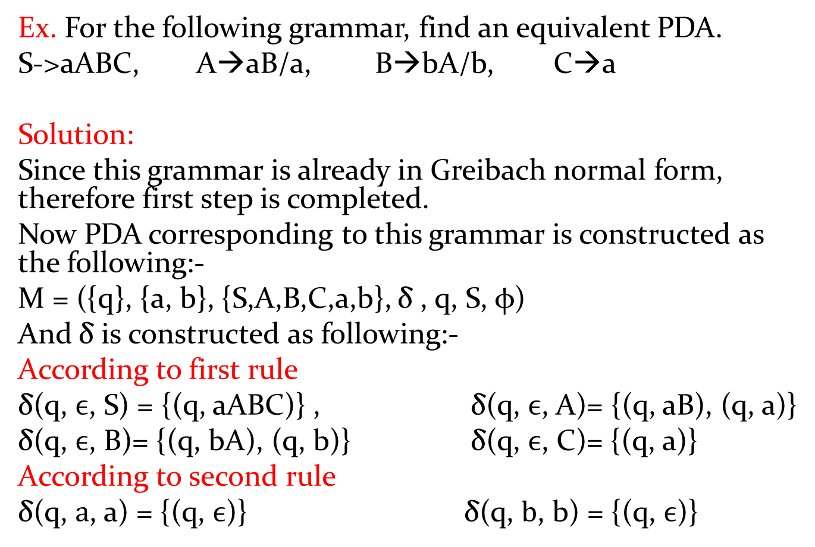
PDA from CFG
Ex. For the following grammar, find an equivalent PDA.
S->aABC, A→aB/a, B→bA/b, C→a
Solution:
Since this grammar is already in Greibach normal form, therefore first step is completed.
Now PDA corresponding to this grammar is constructed as the following:-
M = ({q}, {a, b}, {S,A,B,C,a,b}, δ , q, S, φ)
And δ is constructed as following:-
According to first rule
δ(q, $ϵ$, S) = {(q, aABC)} , δ(q, $ϵ$, A)= {(q, aB), (q, a)}
δ(q, $ϵ$, B)= {(q, bA), (q, b)} δ(q, $ϵ$, C)= {(q, a)}
According to second rule
δ(q, $a$, a) = {(q, $ϵ$)}δ(q, $b$, b) = {(q, $ϵ$)}

Slide 9
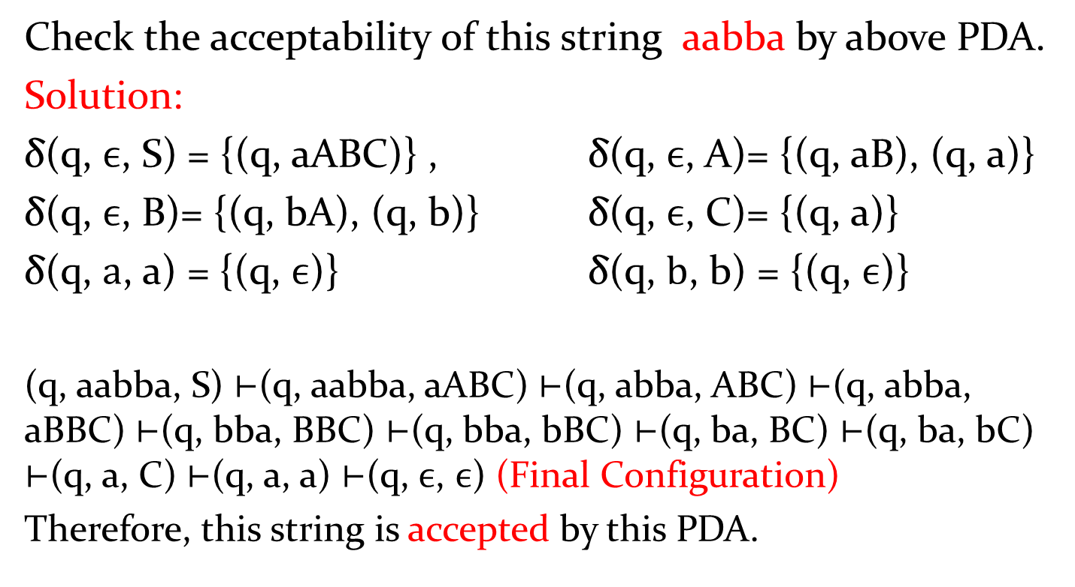
Check the acceptability of this string aabbaby above PDA.
Solution:
δ(q, $ϵ$, S) = {(q, aABC)} , δ(q, $ϵ$, A)= {(q, aB), (q, a)}
δ(q, $ϵ$, B)= {(q, bA), (q, b)} δ(q, $ϵ$, C)= {(q, a)}
δ(q, $a$, a) = {(q, $ϵ$)}δ(q, $b$, b) = {(q, $ϵ$)}
(q, aabba, S) ⊢(q, aabba, aABC) ⊢(q, abba, ABC) ⊢(q, abba, aBBC) ⊢(q, bba, BBC) ⊢(q, bba, bBC) ⊢(q, ba, BC) ⊢(q, ba, bC) ⊢(q, a, C) ⊢(q, a, a) ⊢(q, $ϵ$, $ϵ$) (Final Configuration)
Therefore, this string is accepted by this PDA.

Slide 10
Ex. Construct PDA equivalent to the following CFG,
S→0BB, B→0S/1S/0
And check whether 010000 is in N(M) or not.

